Slide 1
Lesson 3 Shifts in Exponentials

Slide 2
Liner Equations
Slope Intercept Form
Standard Form
$$y=mx+b$$
$$Ax+By=C$$
Exponential Equations
$$y=ab^{x−h}+k$$

Slide 3
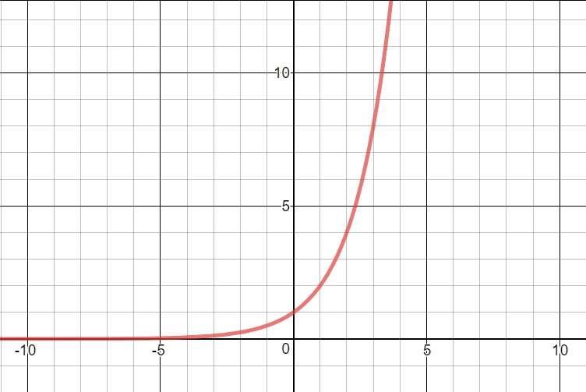
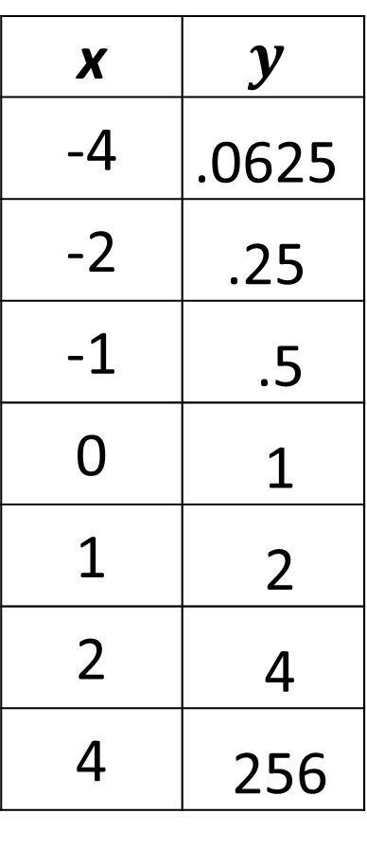
$y=2^{x}$ (Parent Function)
x | $$y$$
-4 | .0625
-2 | .25
-1 | .5
0 | 1
1 | 2
2 | 4
4 | 256

Slide 4
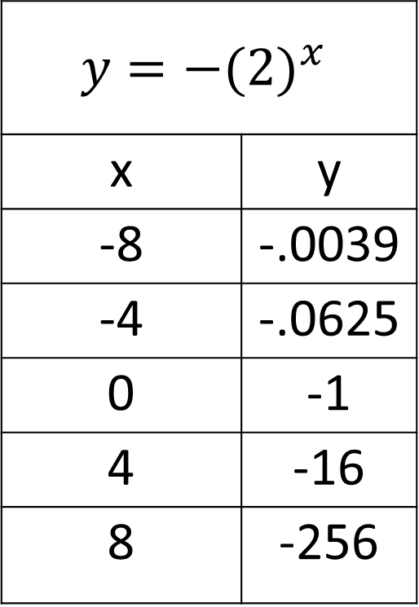
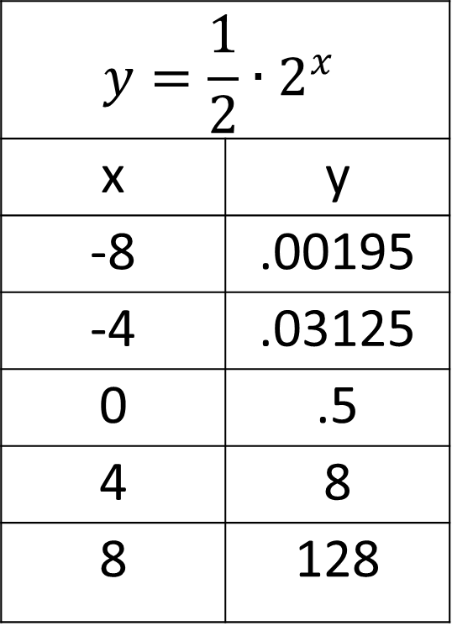
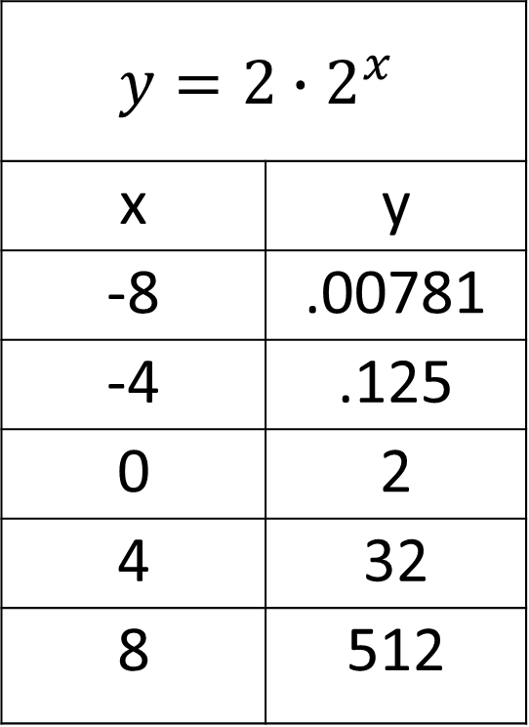
Section 1
$$y=−{(2)}^{x}$$
x | y
-8 | -.0039
-4 | -.0625
0 | -1
4 | -16
8 | -256
$$y={2∙2}^{x}$$
x | y
-8 | .00781
-4 | .125
0 | 2
4 | 32
8 | 512
$$y={\frac{1}{2}∙2}^{x}$$
x | y
-8 | .00195
-4 | .03125
0 | .5
4 | 8
8 | 128

Slide 5
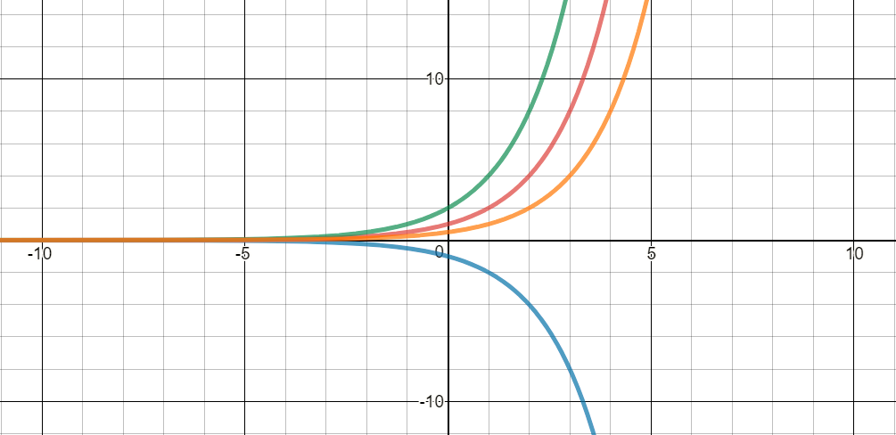
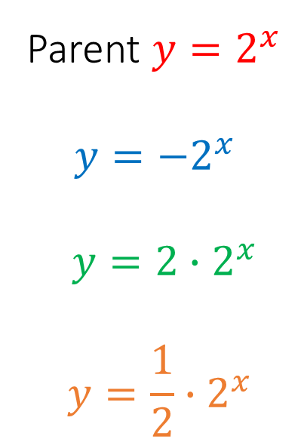
Parent $y=2^{x}$
$$y=−2^{x}$$
$$y=2∙2^{x}$$
$$y=\frac{1}{2}∙2^{x}$$
Shift Variable a | Negative | Fraction | Greater than 1
 | Flip | Compress | Stretch

Slide 6
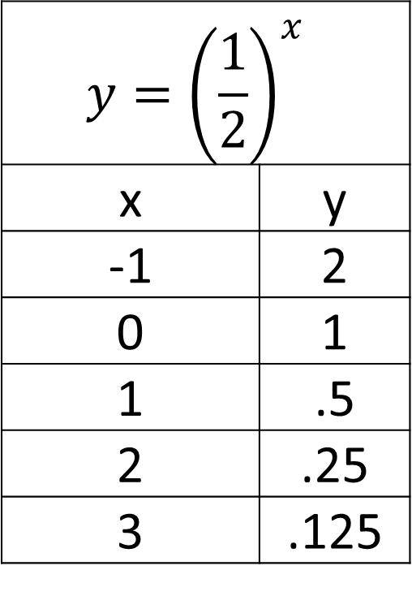
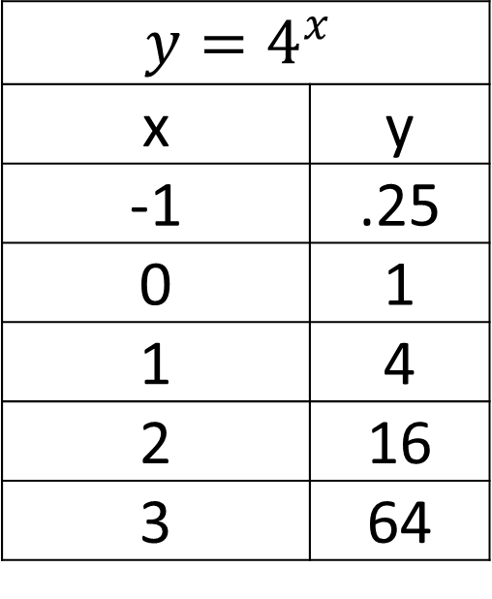
Section 2
$$y={\left(\frac{1}{2}\right)}^{x }$$
x | y
-1 | 2
0 | 1
1 | .5
2 | .25
3 | .125
$$y=4^{x}$$
x | y
-1 | .25
0 | 1
1 | 4
2 | 16
3 | 64

Slide 7
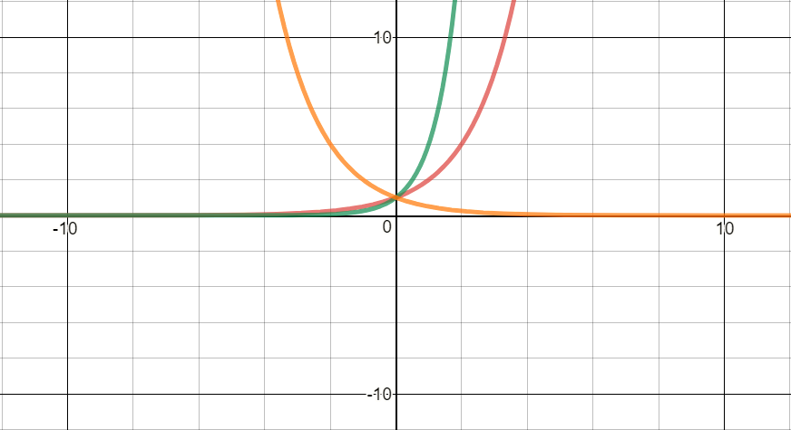
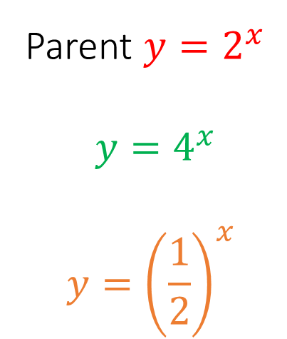
Parent $y=2^{x}$
$$y=4^{x}$$
$$y={\left(\frac{1}{2}\right)}^{x}$$
Shift Variable b | Greater than 1 | Less than 1

Slide 8
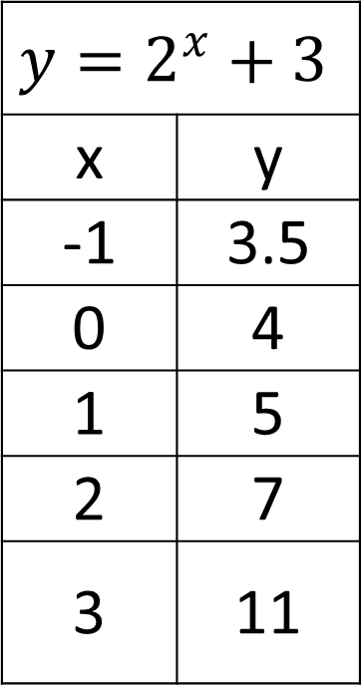
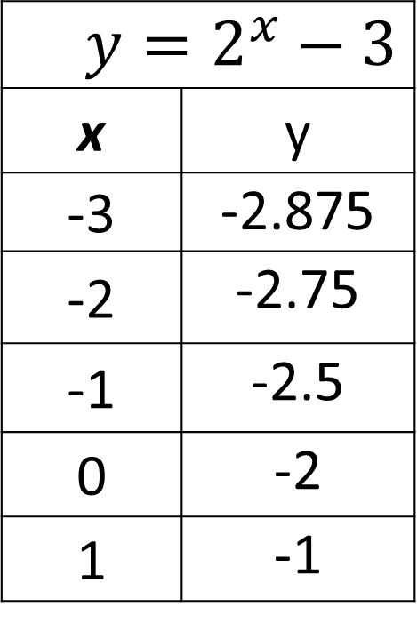
Section 3
$y=2^{x}−3$
x | y
-3 | -2.875
-2 | -2.75
-1 | -2.5
0 | -2
1 | -1
$$y=2^{x}+3$$
x | y
-1 | 3.5
0 | 4
1 | 5
2 | 7
3 | 11

Slide 9
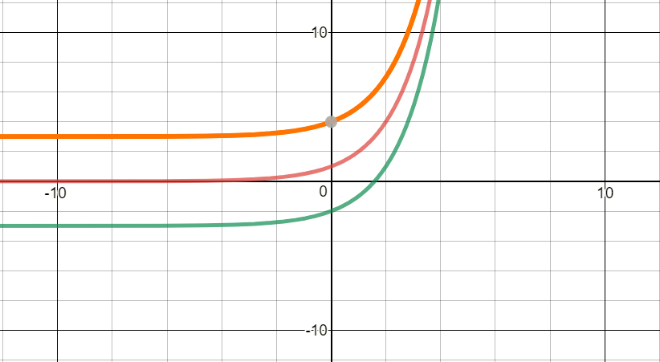
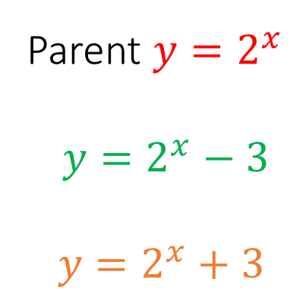
Parent $y=2^{x}$
$$y=2^{x}−3$$
$$y=2^{x}+3$$
Shift Variable k | Positive | Negative
 | Vertical Shift Up | Vertical Shift Down

Slide 10
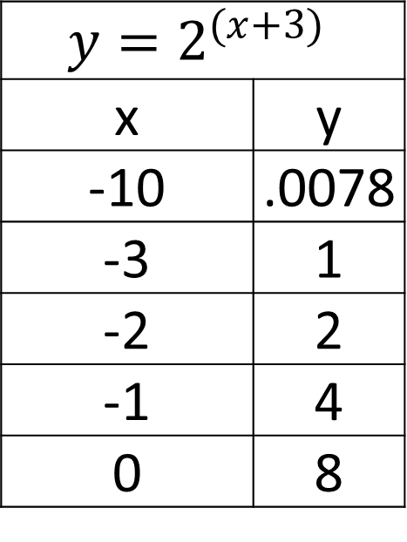
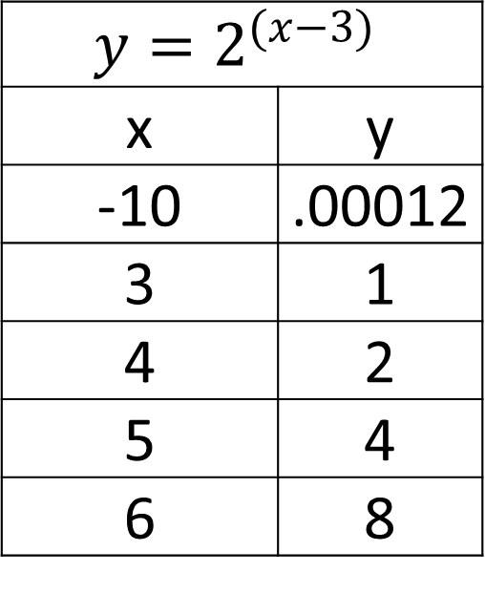
Section 4
$$y=2^{(x+3)}$$
x | y
-10 | .0078
-3 | 1
-2 | 2
-1 | 4
0 | 8
$$y=2^{(x−3)}$$
x | y
-10 | .00012
3 | 1
4 | 2
5 | 4
6 | 8

Slide 11
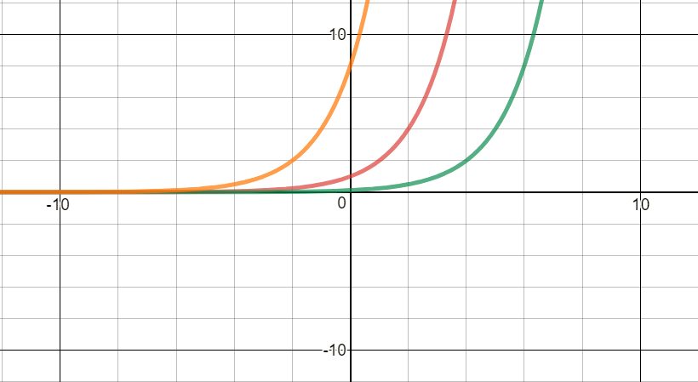
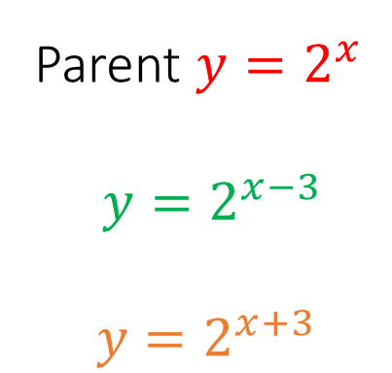
Parent $y=2^{x}$
$$y=2^{x−3}$$
$$y=2^{x+3}$$
Shift Variable h | Positive | Negative
 | Horizontal Shift Right | Horizontal Shift Left

