Slide 1
Lesson 1: What are Exponentials?
I am able to identify the characteristics of an exponential graph
I can tell if a set of data points (t-table) is exponential or not
I can simplify an exponential equations using order of operations

Slide 2
I. I am able to identify the characteristics of an exponential graph
 | Linear | Exponential
Increasing
Decreasing
Positive Slope
Growth
Negative Slope
Decay

Slide 3
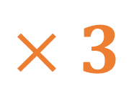
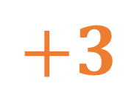
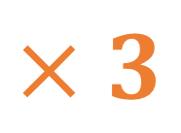
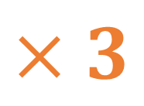
II. I can tell if a set of data points (t-table) is exponential or not
X | Y
1 | 5
2 | 7
3 | 9
4 | 11
X | Y
1 | 1
4 | 3
7 | 9
10 | 27
+1
$$+3$$
$$×3$$
+2
+1
$$+3$$
$$×3$$
+2
+1
$$+3$$
$$×3$$
+2
Linear
Exponential
: Y change by adding a constant number
: Y change by multiplying a constant number
: Y change by subtracting a constant number
: Y change by dividing a constant number

Slide 4
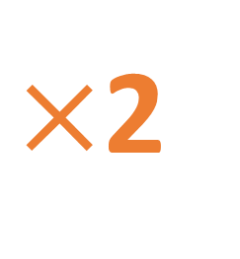
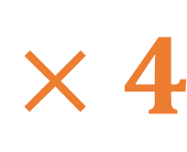
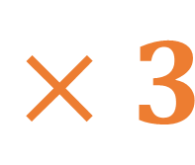
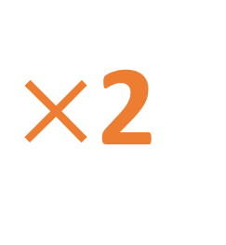
Why are these NOT exponential?
X | Y
1 | 4
2 | 8
5 | 16
9 | 32
X | Y
0 | 2
2 | 4
4 | 12
6 | 48
+1
$×$2
+2
$×$2
+3
$×$2
+2
$$×3$$
+4
$×$2
+2
$$×4$$
Change in X is not constant
Change in Y is not constant

Slide 5
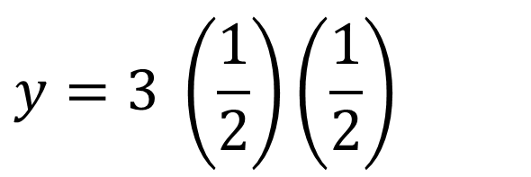
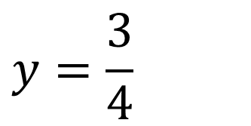
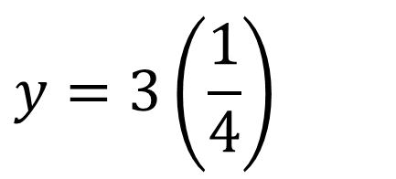
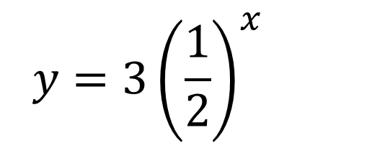
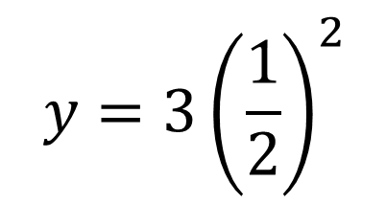
III. I can simplify an exponential equations using order of operations
$$y=3{\left(\frac{1}{2}\right)}^{x}$$
$$x=2$$
$$y=2{\left(5\right)}^{x}$$
$$x=3$$
$$y=2{\left(5\right)}^{3}$$
$$y=3{\left(\frac{1}{2}\right)}^{2}$$
$$y=\frac{3}{4}$$
$$y=2 (5)(5)(5)$$
$$y=2(125)$$
$$y=3 \left(\frac{1}{2}\right)\left(\frac{1}{2}\right)$$
$$y=.75$$
$$y=250$$
$$y=3\left(\frac{1}{4}\right)$$
$$(3, 250)$$
$$(2,.75)$$

Slide 6
Definition of Exponential Functions
A non-linear function
X changes at a constant rate (addition/ subtraction)
Y changes at a constant factor (multiplication/division)

