Slide 1
Lesson 1 Corresponding Parts

Slide 2
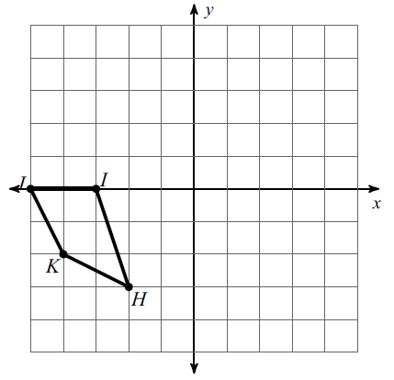
Translate <5, 2>
What are corresponding parts?
Parts that match between two congruent shapes

Slide 3
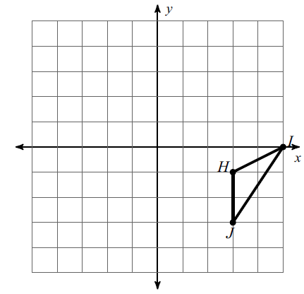
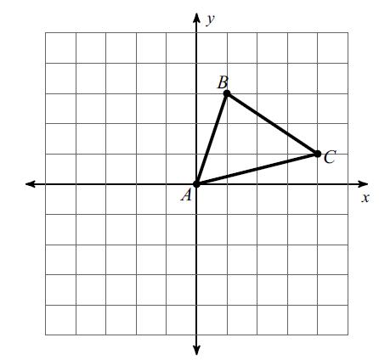
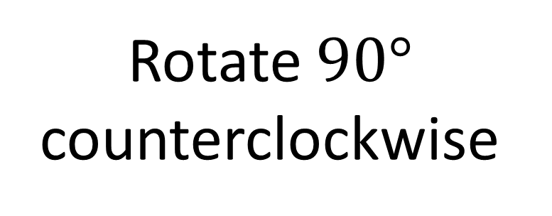
Rotate $90°$ counterclockwise
Reflect across
the y-axis

Slide 4
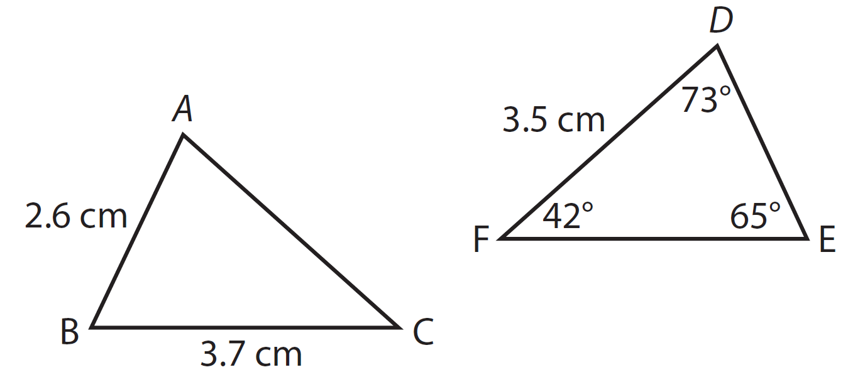
Find the value of DE
Find the value of $∢B$
$$\overline{DE}≅\overline{AB}$$
$$∢B≅∢E$$
$$\overline{DE}≅2.6 cm$$
$$∢B≅∢65°$$

Slide 5
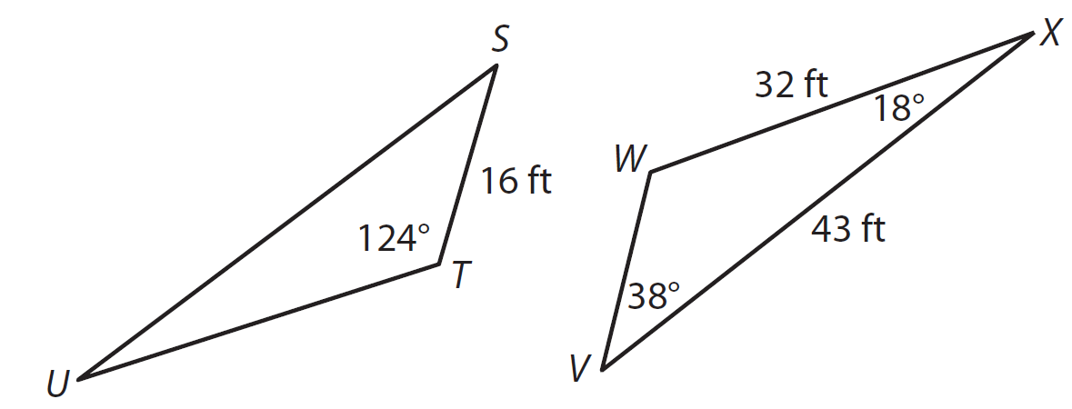
Find the value of SU
Find the value of $∢S$
$$\overline{SU}≅\overline{XV}$$
$$∢S≅∢V$$
$$\overline{SU}≅43ft$$
$$∢S≅∢38°$$

