Slide 1
Alebrijes

Slide 3
My Alebrije
Complete reflection worksheet
Name of your alebrije
Animal(s) used for alebrije
Explanation of why you choose that animal
List colors used for alebrije
Explanation of why you choose to use those colors

Slide 4
Identify Corresponding Parts
Color code the corresponding parts of the triangle

Slide 5
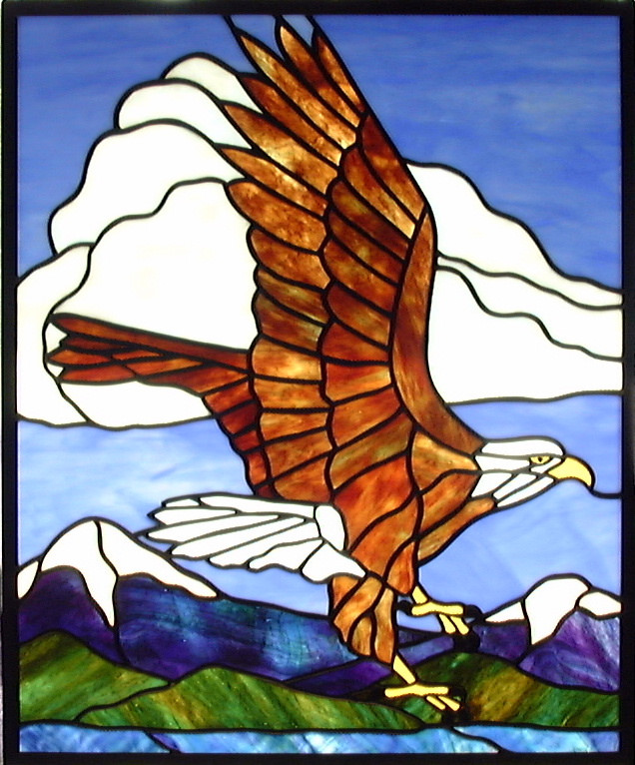
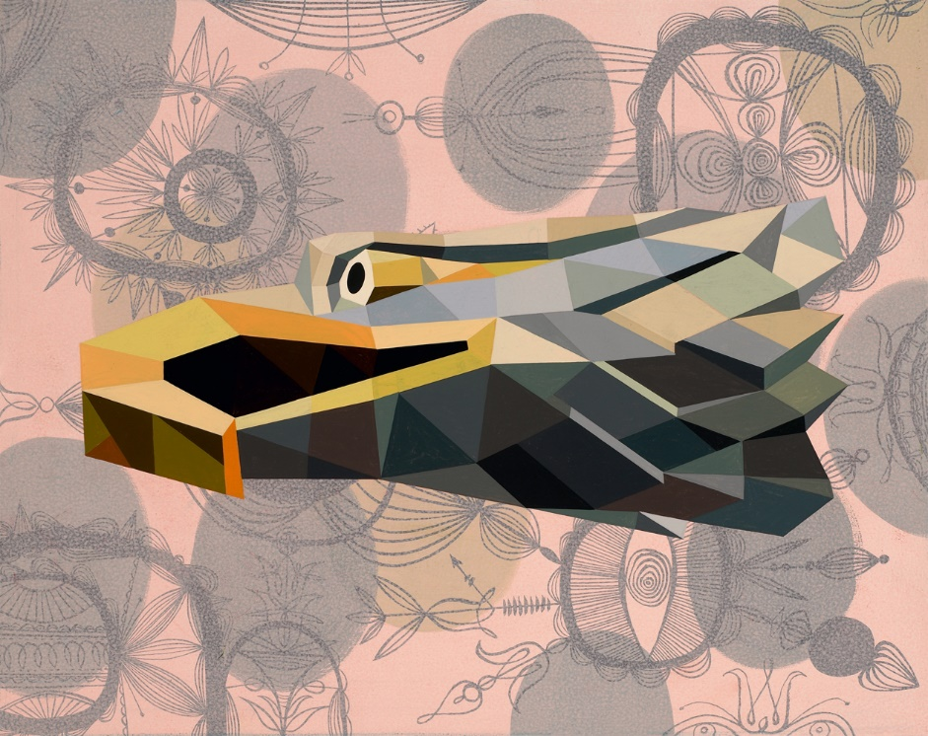
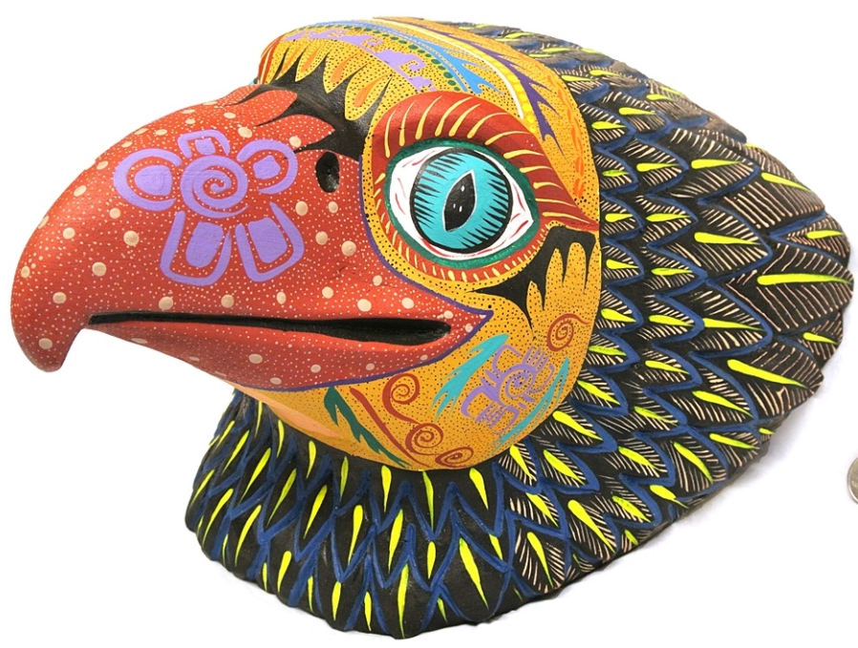
Stain Glass Piece

